Slide 1
Education and Career Choices of Young Australians
A data-driven analysis of post-school education decisions in Australia

Slide 2
Problem Statement
What factors impact young people's decisions to commence and complete post-school studies?
How do these factors influence early career pathway choices?
Key Statistic: 53% of 15–20-year-olds who finished school in 2022 were engaged in post-school study in 2023
Source: Australian Bureau of Statistics' Survey of Education and Work, 2023

Slide 3
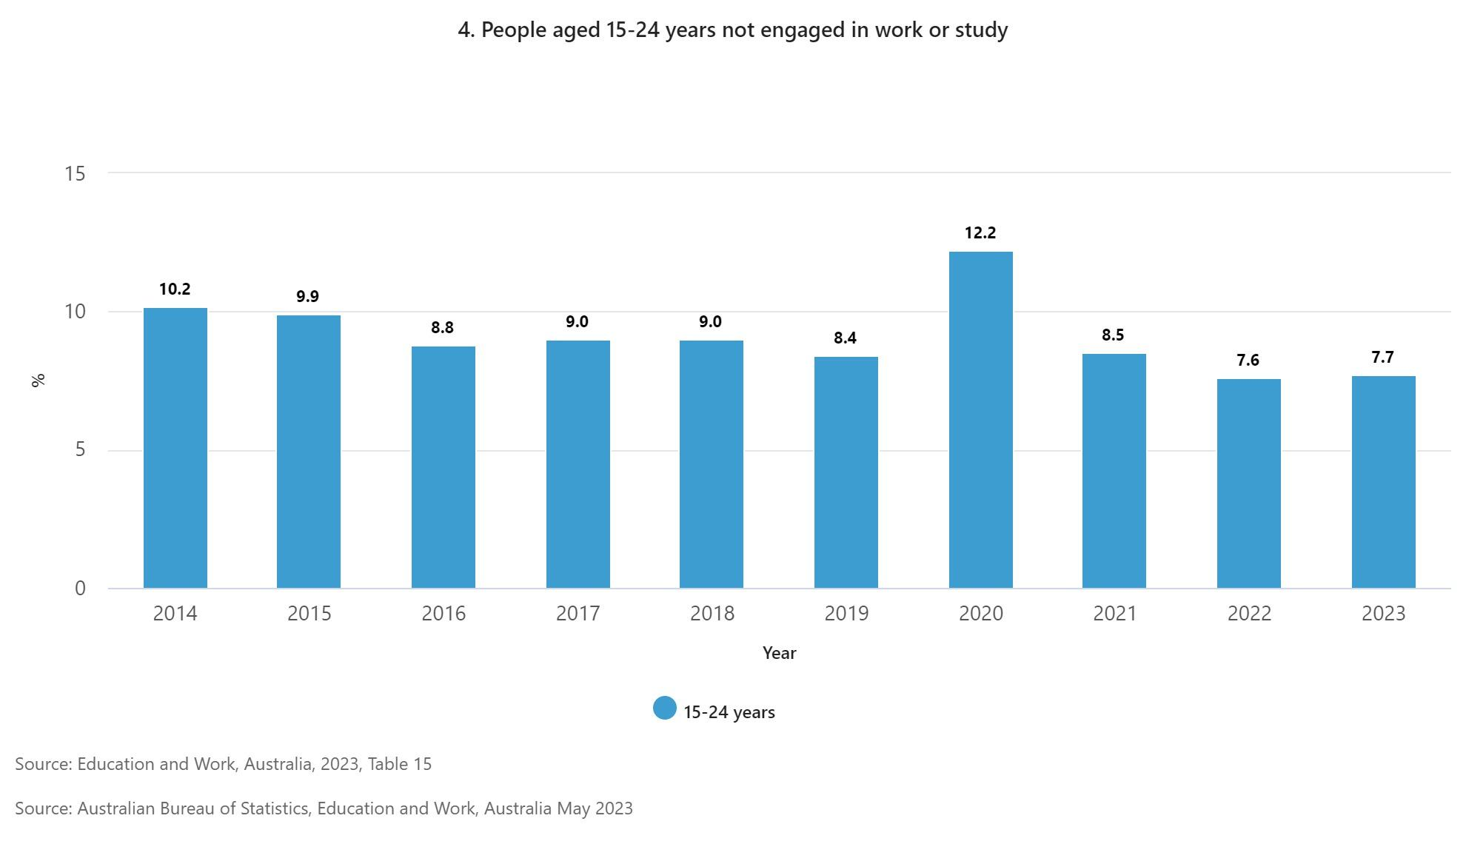

Slide 4
Factor 1: Educational Attainment
Year 12 or equivalent completion rate (20-24 year-olds): 90.1%
Bachelor degree or above (25-34 year-olds): 44.6%
Advanced Diploma/Diploma (25-34 year-olds): 11.2%
Certificate III/IV (25-34 year-olds): 21.1%
Source: ABS "Education and Work, Australia" (May 2023)

Slide 5
Factor 2: Employment Situation
Youth unemployment rate (15-24 year-olds): 8.7%
Youth underemployment rate: 15.5%
Source: ABS "Labour Force, Australia" (April 2024)

Slide 6
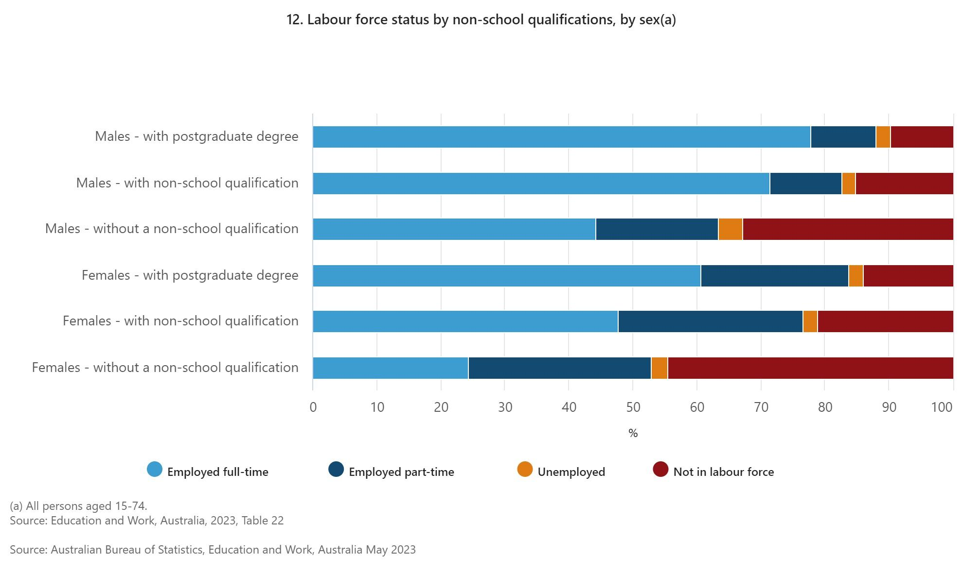

Slide 7
Factor 3: Financial Situation
Median weekly household income: $1,759
Proportion of households with income in the lowest quintile: 20%
Average HELP debt: $23,685
Number of HELP debtors: 2.9 million
Sources: ABS "Household Income and Wealth, Australia" (2021-22), HECS-HELP debt statistics (2022-23)

Slide 8
Factor 4: Geographic Location
Population in Greater Capital Cities: 67.7%
Population in rest of state areas: 32.3%
Bachelor degree or above (major cities): 35.1%
Bachelor degree or above (very remote): 14.6%
Sources: ABS "Regional Population" (2022-23), Educational attainment by remoteness (2021)

Slide 9
Factor 5: Health and Disability
Proportion of 15-24 year-olds with disability: 9.3%
Labour force participation rate (with disability, 15-64 years): 53.4%
Labour force participation rate (without disability, 15-64 years): 84.1%
Source: ABS "Disability, Ageing and Carers, Australia" (2018)

Slide 10
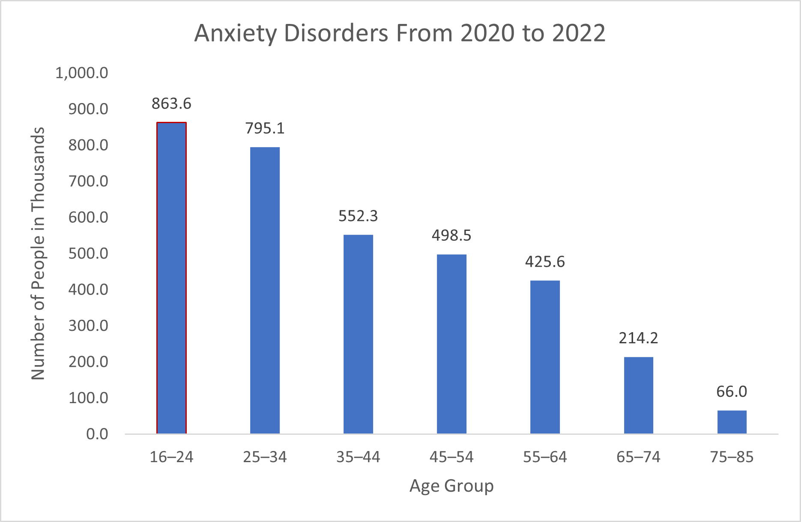
Mental health plays a key role and when we see the increase in anxiety disorder amongst 16-24 year olds, we also see a correlation with the substance use amongst the same age group increasing.

Slide 11
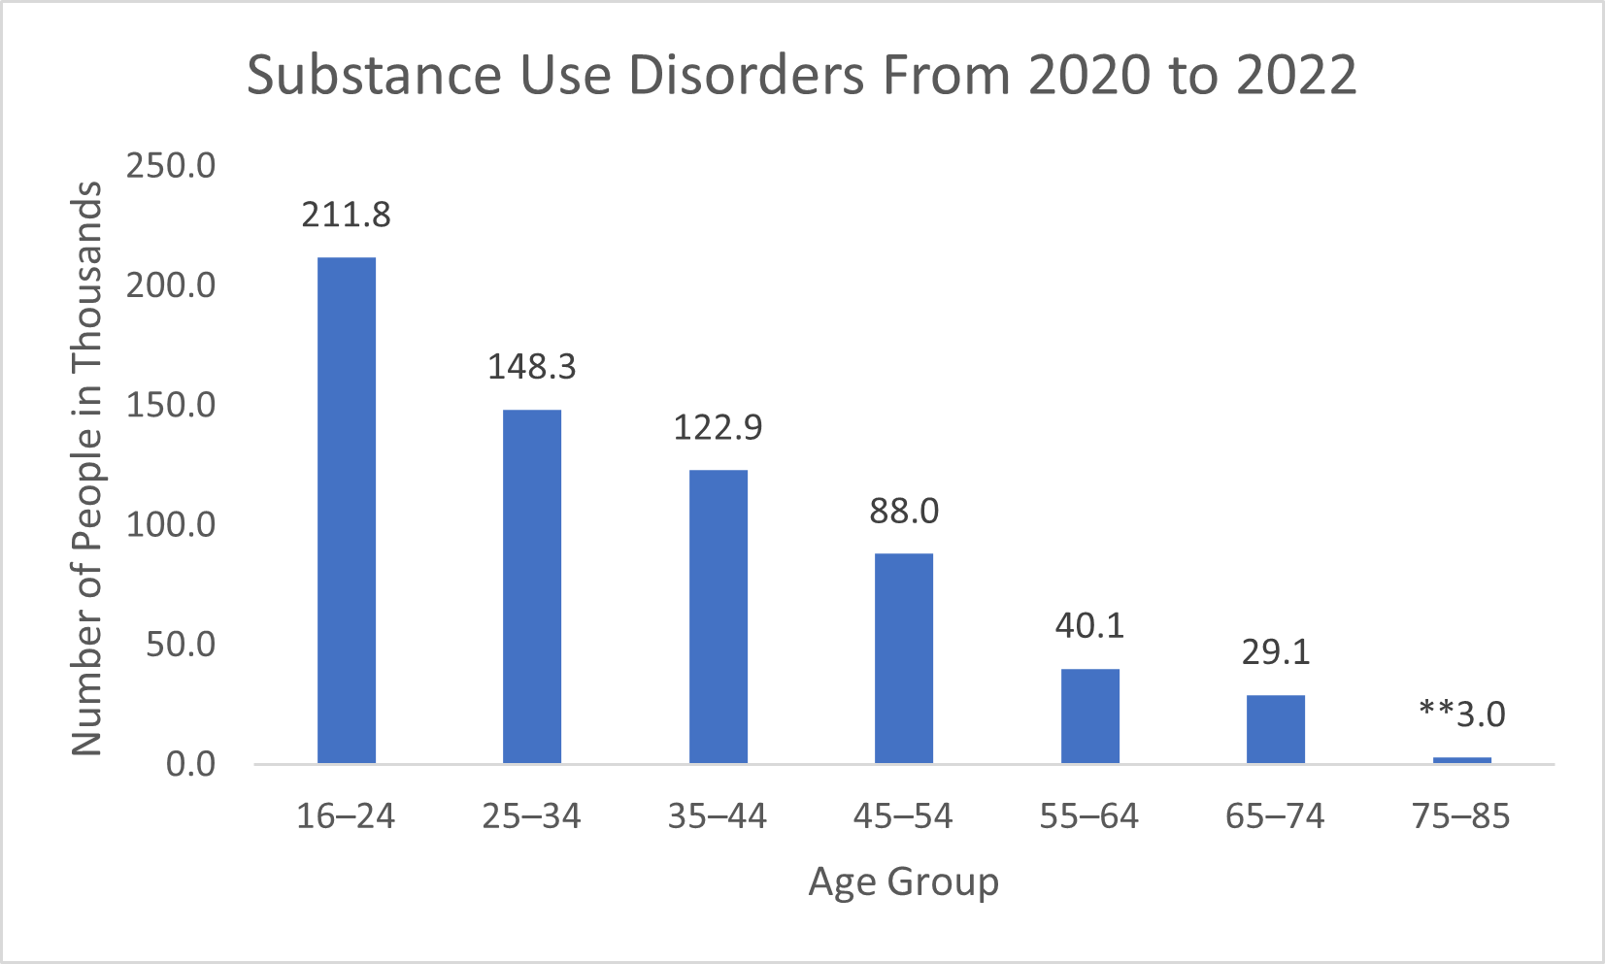
Anxiety disorder and substance use disorder data is increasing parallelly with mostly 16-24 age group, which shows a major concern. This might be happening, with the use of liquid Vapes, legal Marijuana prescription and loopholes where youth might have chosen.

Slide 12
Career Perceptions and Expectations
25-year-olds who believe their post-school qualification was worth the time and effort: 76%
Those who believe their qualification helped them get a job: 64%
Source: Longitudinal Surveys of Australian Youth (LSAY)

Slide 13
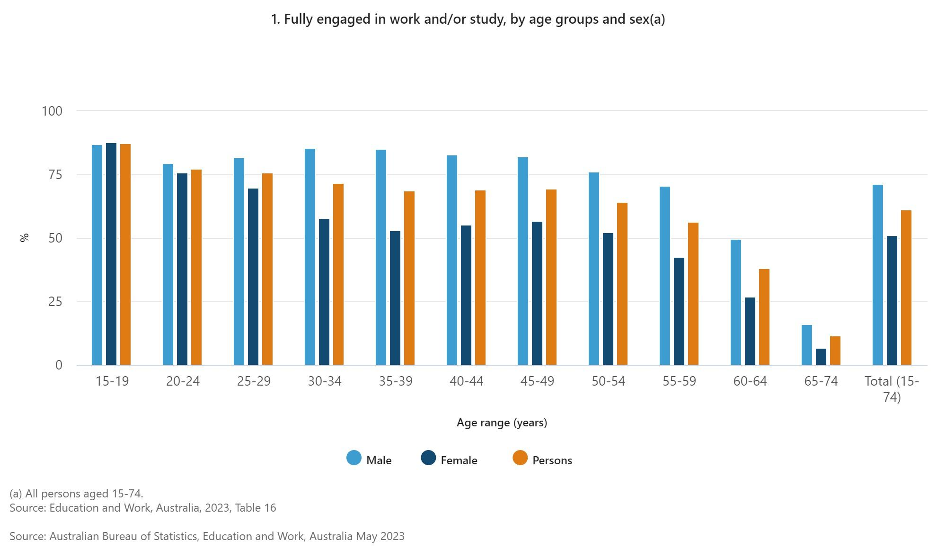

Slide 14
AI and Government Data for Prediction
Data sources:
ABS Census data
LSAY data
Higher Education Information Management System (HEIMS)
National Centre for Vocational Education Research (NCVER) data
Approach:
Integrate multiple data sources
Use machine learning algorithms for predictive modeling
Validate models using historical data and out-of-sample testing

Slide 15
Machine Learning Models
1. Predictive Models:
Random Forests for predicting post-school study engagement
Gradient Boosting for estimating likelihood of completing tertiary education
Neural Networks for predicting early career pathways
2. Clustering Models:
K-means clustering to identify distinct groups of students based on their characteristics and choices
Hierarchical clustering to understand nested relationships between factors

Slide 16
Time Series Analysis and Forecasting
ARIMA models for forecasting trends in educational attainment
Prophet model for predicting future enrollment rates
LSTM networks for capturing long-term dependencies in career progression

Slide 17
Natural Language Processing (NLP)
Sentiment analysis of student feedback and career expectations
Topic modeling of career aspirations and concerns
Text classification of open-ended survey responses

Slide 18
Model Evaluation and Validation
Cross-validation techniques (e.g., k-fold, stratified k-fold)
Performance metrics (accuracy, F1-score, ROC-AUC)
Feature importance analysis
Model interpretability techniques (SHAP values, LIME)

Slide 19
Trend Identification and Insights
Identification of key factors driving educational choices
Detection of emerging trends in career preferences
Analysis of the impact of socioeconomic factors on educational outcomes
Prediction of future skill demands and educational needs

Slide 20
Conclusion and Recommendations
Reduce geographic and socioeconomic disparities in educational access
Enhance career guidance programs, particularly in rural and remote areas
Develop targeted support for students with disabilities
Implement data-driven interventions based on predictive modelling results
Conduct regular surveys to monitor changing perceptions and expectations

Slide 21
Next Steps
Conduct in-depth analysis of LSAY data for longitudinal insights
Collaborate with universities and TAFE institutions for more granular data
Develop a pilot predictive model using integrated government datasets
Design and implement targeted interventions based on identified trends
Establish a framework for ongoing monitoring and evaluation of outcomes

